Slide 1
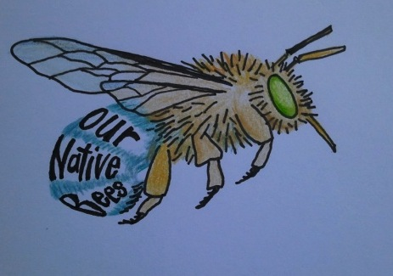
Native Bee Project Building on the Buzz: A Case Study Native Bee Awareness Project led by Transition Adelaide Hills David Lloyd, Jenny Deans, Sally Shaw, Simon Goodhand, Bron McNabb, Chris Thornton, Keri Chiveralls
Who?
What?
Why?
How?
Evaluation
And then what?
Notes:
The Native Bee Awareness Project: The who, what, why, and How – not necessarily in that order!

Slide 2
Who and What?
Transition Adelaide Hills TAH
Sustainability, movie series, event management and catering
Sturt Upper Reaches Landcare Group SURLG
Public speaker series and environment education interests
Old School Community Garden, Stirling OSCG
Workshop series, venue, gardening interests
Notes:
The Native Bee project has been a collaboration between 3 organisations: list organisations involved and what they brought to the project.

Slide 3
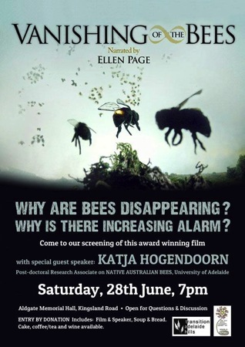
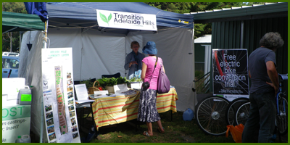
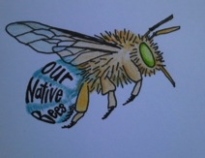
Transition Adelaide Hills Building community resilience; Supporting community responses to climate change and shrinking supplies of cheap energy.
Native Bee Awareness Project 2015
Bee Hotel Workshop
31st May 2015
June 2014
Notes:
TAH initiatives include food swap, community garden, upcycled creations, electric bicycle project and series of sustainability film nights

Slide 4
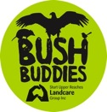
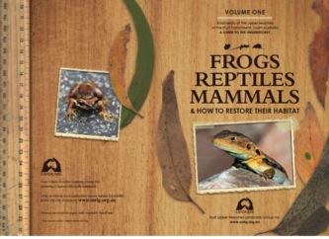
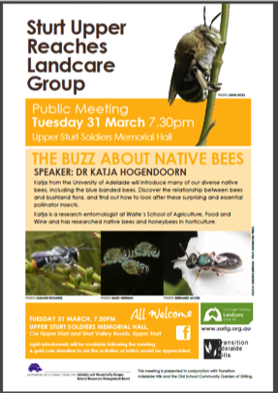
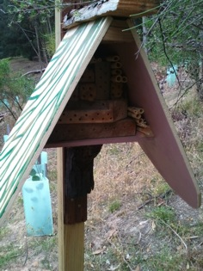
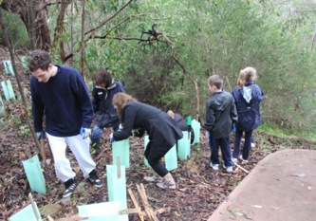
Sturt Upper Reaches Landcare Group
Connecting people with nature and each other
Public awareness
Practical activities
August 2014
Notes:
Sturt Upper Reaches Landcare Group – nearly 20 years and going strong. Demonstration revegetation site retaining bandicoot habitat, Fauna guide booklet, speakers series

Slide 5
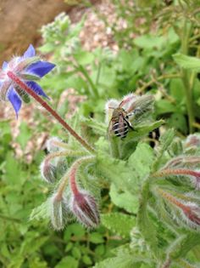
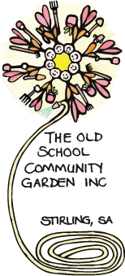
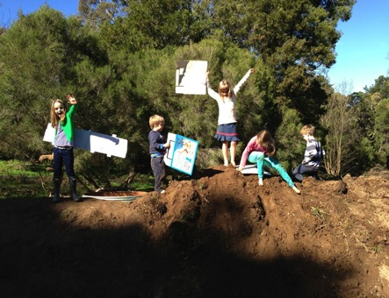
The Old School Community Garden at Stirling
Stirling area locals growing, learning, and having fun
a meeting place, a growing place, a learning place,
a healthy place, a sustainable place and a beautiful place
Notes:
3 years old, community instigated garden for community, a community growing learning and beautiful place.

Slide 6
Why
Impetus for project
General awareness of Honeybee colony collapse
Discovering the value of native bees as pollinators
Valuing biodiversity
The concept of eco-justice
Recognising the need to reconnect communities to natural environments
Stemmed from two independent ideas/initiatives:
Interest in Honeybees
(awareness about decline of bee populations and food security issues), and
‘Schools for Biodiversity’ education project for primary schools with remnant bush
(biodiversity assessment and awareness, support and resources, ‘ABC’ approach)
Notes:
ABC awareness, belonging, caring for native animals and plants. Movie; Vanishing of the Bee, with expert speaker Dr Katja Hogendoorn on the local honey bee situation in SA – eg varroa mite and native bees as insurance pollinators.
Science week theme ‘food for the future.

Slide 7
How
Evolution of interest and development of activities by the groups included:
‘Bee Movie’ night and talk June 2014 expert advice
Science Week workshops Aug 2014 hook idea and practical skills
community interest group connections between formed July and formalised Sept 2014 people and groups
‘Native Bee Project’
Application for an AMLR NRM community grant to deliver workshops
Notes:
ABC awareness, belonging, caring for native animals and plants. Movie; Vanishing of the Bee, with expert speaker Dr Katja Hogendoorn on the local honey bee situation in SA – eg varroa mite and native bees as insurance pollinators.
Science week theme ‘food for the future.

Slide 8
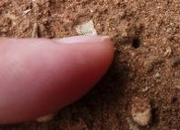
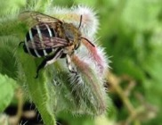
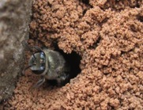
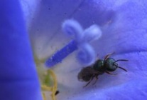
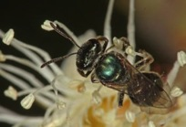
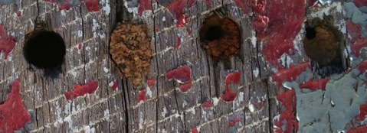
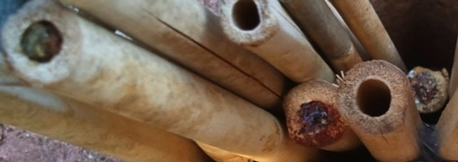
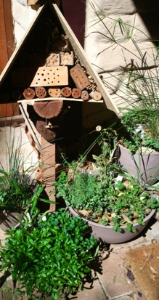
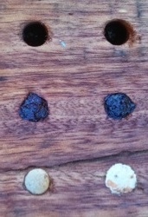
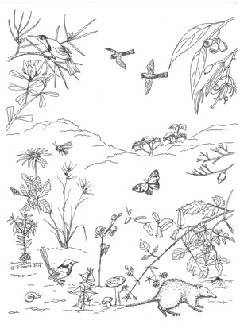
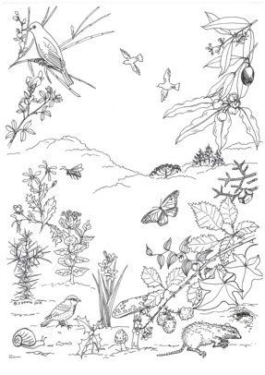
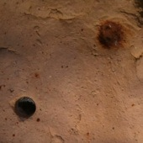
Susanne Richards
Rachelle Sandow
Heather Whiting
Heather Whiting
Marc Newman
Native Wonderland
Alien Invasion
Spot the Difference
Blue Banded Bee
(Feral)Honeybee
Notes:
For those new to native bees – we have blue-banded bees, burrowing bees and small metallic bees – a great ‘hook’ to understanding biodiversity. Everyone knows that ‘bees are yellow and black’! Spot the difference native and exotic plants, animals and landscapes.

Slide 9
Native bee project: What and How (and When)
Decisions: determining the important messages from the science, the target audience and desired behaviours toward more sustainable actions late 2014 and early 2015
Display at Uraidla Sustainability Fair 21 February 2015
Public talk Dr Katja Hogendoorn at Landcare 31 March 2015
Workshops with activities selected to reflect key messages 31 May 2015, 11 Oct 2015
Signs for ongoing awareness, information and reference draft for 21 February final September 2015
Bee hotel construction at community garden September 2015
Information handouts/emailouts (with encouragement to pass on) bee facts, ‘bee plants’, how to build bee hotels, etc
Project philosophy: Consistency with ‘Love.Not Loss’ IUCN campaign and Doug McKenzie-Mohr 'Fostering Sustainable Behaviour using Community-Based Social Marketing' seminar approaches.
Notes:
Sequence of activities that have been part of the Native Bee project:. Love.not Loss: personalise, humanise, publicise. Doug McKenzie-Mohr: 1 select behaviour to be promoted, 2 identify barriers and benefits, 3 develop strategy to address 2, 4 pilot the strategy, 5 broad-scale implementation and evaluation.

Slide 10
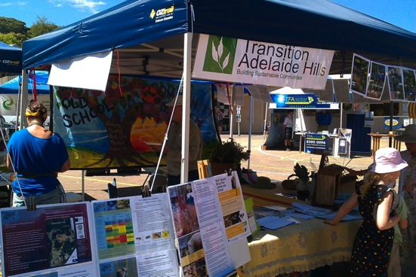
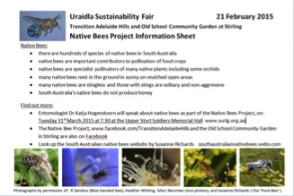
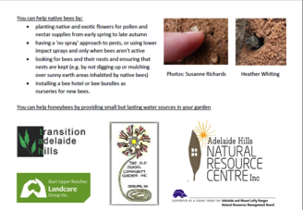
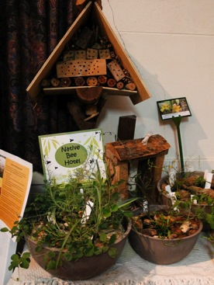
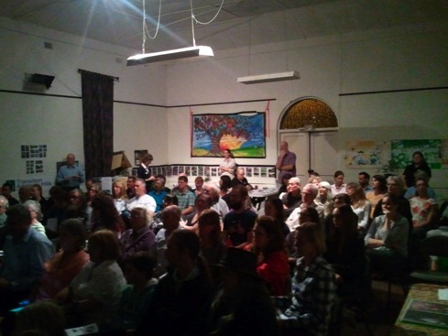
Notes:
Sustainability Fair handouts inviting people to talk by Dr Hogendoorn and including information on native bees and how to care for them. Talk included registration for native bee workshop.

Slide 11
Workshops
Publicity though:
Registration at the public talk
Local newspapers
Local community radio
Networks of the three community groups involved
ACFCGN, NRM newsletters/facebook, Adelaide Botanic Gardens Kitchen Gardens e-newsletter
Eventbrite online event bookings
‘Trainer training’ with dry run for members of groups
Workshop format: ½ day with four parallel streams
Information on bee diversity, life cycle, ecology, vulnerability to pesticides,
Bee bundles – nesting material for resin bees and carpenter bees
Bee food – planting local native plants, also information on suitable exotic plants
Mud blocks – nesting material for resin and blue-banded bees also emphasising that many native bees nest in the earth and that un-mulched areas are needed.
Evaluation at end of workshop
Notes:
Planning and delivery of the workshops. All publicity included strong restating of key messages.

Slide 12
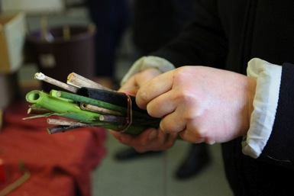
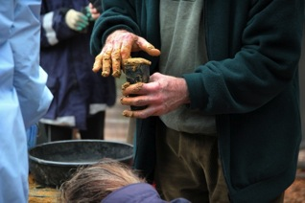
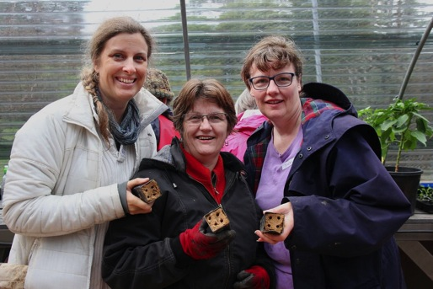
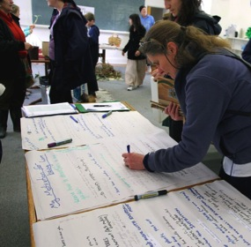
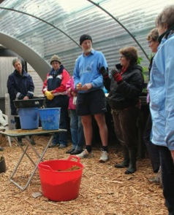
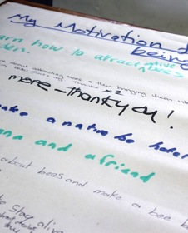
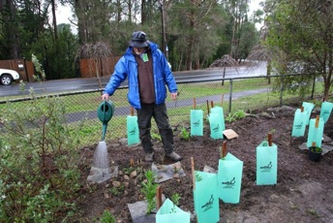
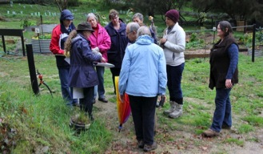
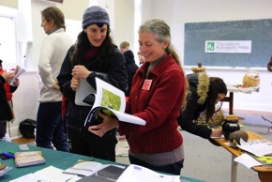
Notes:
The first workshop a cold and rainy day, and warm and enthusiastic crowd of 40 attendees. The photographer was not quick enough to get photos of the excellent selection of cakes.

Slide 13
Evaluation part 1
Movie and talk: 80+ attendees, 8 people attended a meeting afterwards to brainstorm local actions to follow-up issues identified.
Science Week: evaluation by students, volunteers and teachers.
Public Talk: 80+ talk attendees, 12 registered interest in the follow-up workshop, 3 attended.
Signs input and review – Dr Hogendoorn content review, TAFE (IPM), Sophie Thomson, Australian City Farms and Community Garden Network State meeting and National AGM, inclusion of information in TAFE subjects.
‘It's the layers of presentations that ignite, build interest and then give the knowledge and confidence to have a go.’
Rose Dow, teacher, Arbury Park Outdoor School and attendee of Native Bee Project events.
Notes:
A mix of formal and informal evaluation of activities leading up to and in the native Bee project.

Slide 14
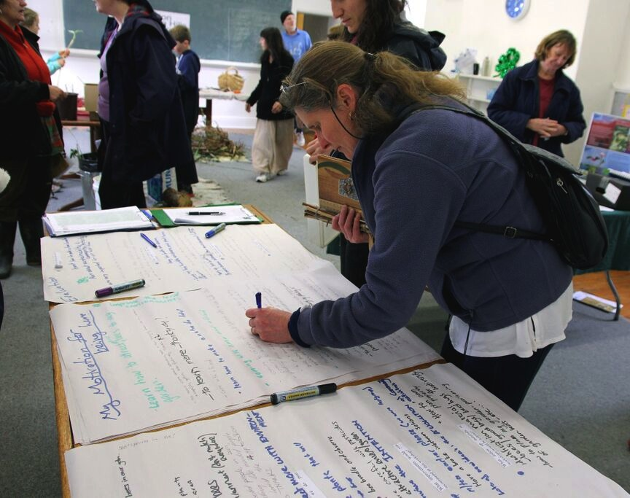
Evaluation of Workshop
Project Outcomes: Knowing, Valuing and Acting
participant learning – the cognitive,
connection to the natural environment both personal & community – the affective
commitment to making a difference – intentional

Slide 15
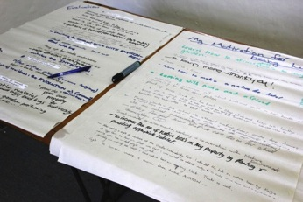
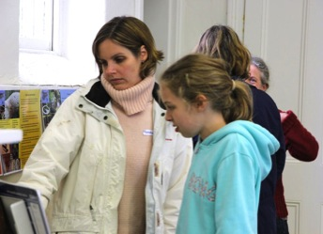
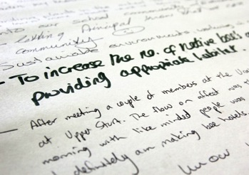
Evaluation of workshop
Approx 70 comments from 40 participants
Evaluation questions:
My motivation for being here.
What have we learned and what is of most value?
What can/will we do post workshop?
What improvements would you recommend in this workshop?
What follow up materials or workshops would be helpful?
Learning
‘Number and variety of native bees.’
‘What bees’ homes look like.’
‘Never realized that the little holes in the ground were native bee homes.’
‘Importance of habitat/environment (don't mulch everywhere).’
Feeling
‘Loved meeting like-minded people.’
‘Enjoying the workshop’
‘Connect more with the environment’
Doing
‘Take my kids on a native bee walk to find their
natural homes on our property.’
‘Share with fellow teachers and plan activities
to do with school groups.’
‘Being more careful with pesticides.’
‘Plant more plants that will attract native bees.’
‘Sit and watch and value the diversity of my garden more.’
Notes:
Most structured evaluation was for the workshop, using butchers paper. Excellent participation in evaluation process and useful feedback.

Slide 16
Signs
Eight signs set along a trail through the community garden.
Four of the signs on external fences, with popular walking paths (Hahndorf Pioneer Women’s Trail and Heysen Trail).
Themes:
General awareness of native bees and map of trail
Bee food plants (exotic and native)
Pesticide use and potential toxicity to bees and other beneficial organisms
Native bee diversity
Ground-dwelling habit of bees and need for un-mulched areas
Bee hotel and bee nest hole enclosures
Non-necessity for providing water (but water provision benefits for biodiversity in gardens generally, eg butterflies).
Notes:
Drafts of the signs have been used at multiple activities. The sign themes reflect the key information identified at the beginning of the project.

Slide 17
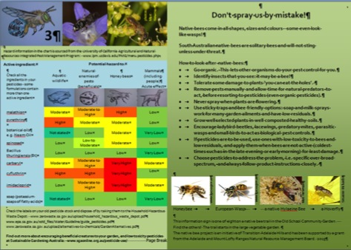
Notes:
Four of the eight signs. Sign no 5 added following the workshops, due to the interest in seeing photos of the variety of bee species (around 500 in SA). Design objective was to be colourful and attract attention but also to have detailed information as a good reference.

Slide 18
What now?
Complete grant commitments
Second workshop 11 October
Bee hotel construction September
Broaden audience
Adelaide Hills Outdoor Playgroup
Arbury Park Environmental Education – insect hotels
NRM Ed (sustainable gardens)
TAFE Hort, C&LM
The Joinery and Common Ground Community Garden
AHC Library brochure for bee trail
Broaden message delivery
Information handouts (register your email!)
You
Notes:
We have a sheet to add your email contact for copies of the ‘handouts’ covering general native bee information, making bee hotels and what plants to grow (Adelaide Hills area).

Slide 19
Useful websites
Love.Not Loss www.iucn.org/lovenotloss
SA native bees southaustraliannativebees.webs.com
PaDIL www.padil.gov.au/pollinators/about
Aussie bee www.aussiebee.com.au
UC IPM www.ipm.ucdavis.edu
SGA www.sgaonline.org.au
Atlas of Living Australia www.ala.org.au
Bowerbird www.bowerbird.org.au
Notes:
PaDIL Pest and Disease Information Library, UC IPM University of California Integrated Pest Management, SGA Sustainable Gardening Australia

Slide 20
Thanks to all the TAH, SURLG and OSCG volunteers who made this project possible, Dr Hogendoorn for answering our many questions and the photographers who gave permission for us to use their glorious photographs in information sheets, signs and promotional materials.
Photo: Marc Newman
Notes:
Thanks to all the volunteers and the photographers, and Katja and Remko who came out to the garden and answered our many questions.

